Slide 1


Social Buzz’s
Content Categories Analysis

Slide 2


Today's agenda
Project recap
Problem
The Analytics team
Process
Insights
Summary

Slide 3

Social Buzz is experiencing rapid growth in terms of number of users and available data. To help manage this huge scale, Accenture has embarked on a 3-month pilot with Social Buzz to:
• Carry out an audit of their big data practice
• Proffer recommendations to ensure success of the forthcoming IPO
• Carry out an analysis of Social Buzz’s content categories in order to highlight the top 5 categories with the largest aggregate popularity
Project Recap

Slide 4

Problem
Due to the rapid growth and digital nature of Social Buzz’s core product, the amount of data that they create, collect and must analyze is huge. Every day over 100,000 pieces of content, ranging from text, images, videos and GIFs are posted. All of these constitute highly unstructured data that requires expertise in handling. Social Buzz’s biggest challenge is how to capitalize on this data to gain a deeper understanding of its audience and therefore provide a more personalized and enjoyable experience.

Slide 5



The Analytics team
Andrew Fleming – Chief Technical Architect, Accenture
Marcus Rompton – Senior Data Expert, Accenture
Shivam Shinde–Data Analyst, Accenture

Slide 6
Process
1
Data Understanding: Understand the data model and domain of your business
Data Extraction: Architected what an ideal dataset should look like for this problem and extracted it from the relevant data sources
2
Data Modelling: Process and model the data into a dataset that can precisely answer the business questions and produce analytics.
3
Data Analysis: Use analytical expertise to uncover insights from the dataset and to produce visualizations to describe the insights.
4
Recommendations: Use insights to unlock business decisions and make recommendations on next steps
5

Slide 7

Insights
Photo
6589
25.4%
animals
1897
7.72%
heart
1622
6.6%
Highest Count for Content Type
Highest Count for Category Type
Highest Count for Reaction Type

Slide 8
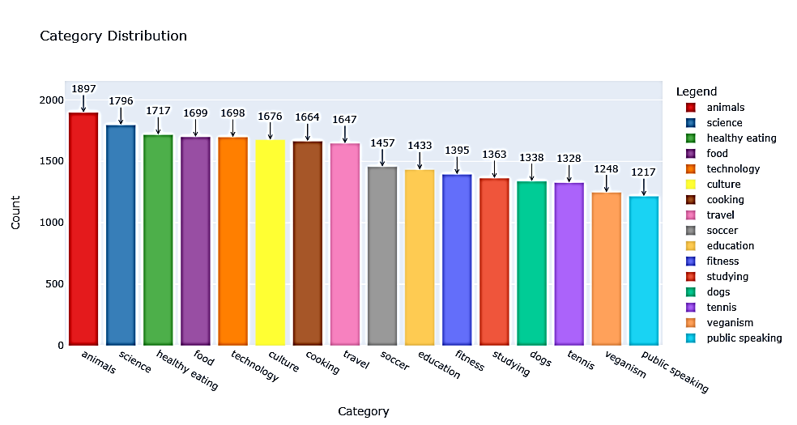
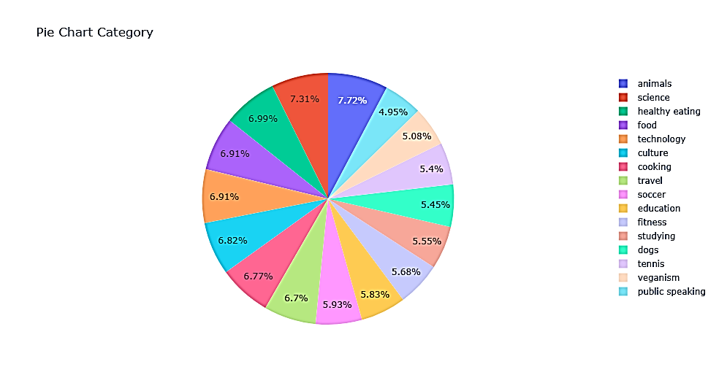
According to our analysis, the top 5 content categories are Animals, Science, Health Eating, Food, and Technology in descending order.

Slide 9
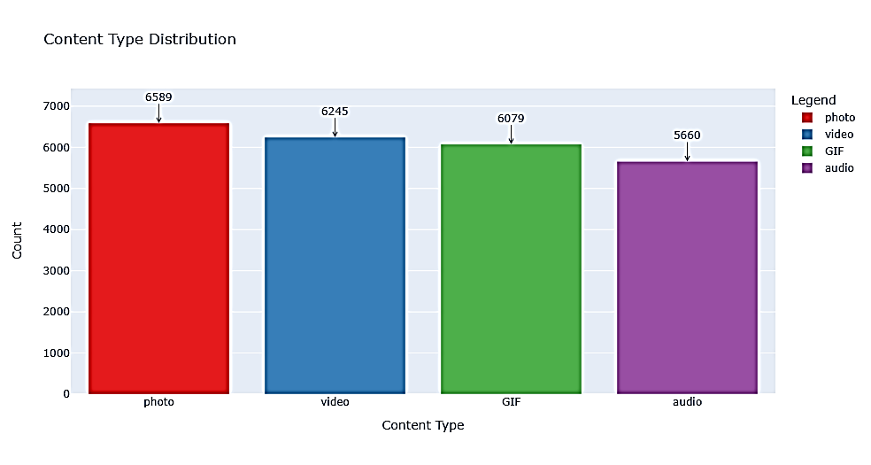
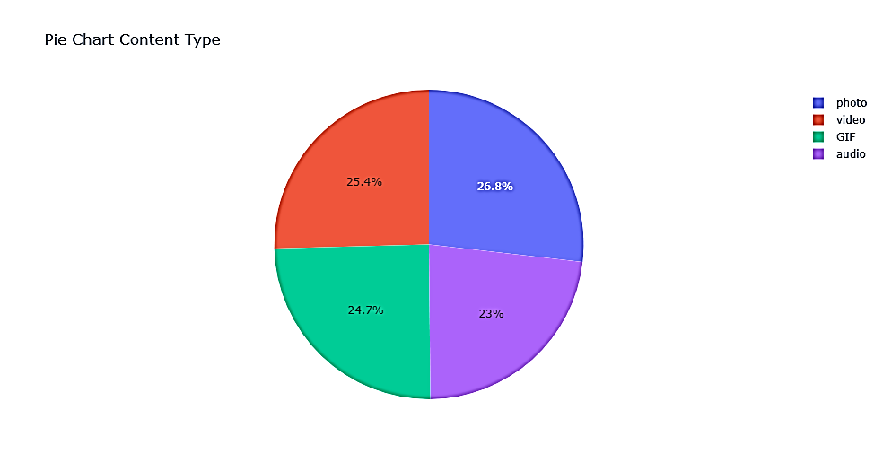
According to our analysis, the most reacted content type is photo followed by videos which is in turn followed by GIF and then audio

Slide 10

Animals and Science are the two most popular content categories indicating an innate tendency to seek connections with nature and facts
Summary
Healthy eating and food fall in the top 5 category with healthy eating outperforming food by 0.76%. This is a broad indication of an audience within Social Buzz’s user base. Creating campaigns, working with influencers and brands that support healthy eating and healthy lifestyle can help to boost growth in these 2 categories.
Social Buzz can leverage holiday seasons to boost growth and user engagement with the food content category via relevant social media strategies.

Slide 11
Thank you!
ANY QUESTIONS?

